Slide 2
Fluent UI/Office UI Fabric
Harsha Vardhini

Slide 3




Harsha Vardhini
Senior SharePoint Developer & Consultant
Developer | Teacher | Trainer
A developer who loves to develop, contribute and learn together with the community.
harshachiku@hotmail.com
https://www.linkedin.com/in/harshavardhinii/
@harshagracy
https://www.c-sharpcorner.com/members/harsha-vardhini

Slide 4
Introduction to Fluent UI
Fabric Core
Fabric React
Fluent UI in SPFx

Slide 5
Introduction of fluent UI

Slide 6

Introduction to fluent UI
Built by Microsoft
All about styling instead of JS
Integrates with other frameworks
Language support
Bootstrap for Office, Office 365, and SharePoint
Where Fabric can be used?
SharePoint Apps
Office 365 Add-ins (Apps)
Windows/Mac desktop
Android/ iOS
Web Client(OWA, OneDrive)
ASP.NET MVC
Any HTML,CSS,JS

Slide 7
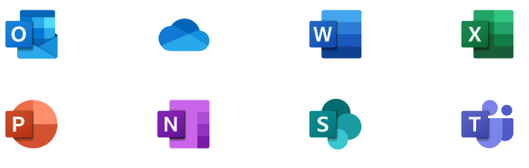
Introduction to fluent UI
The fluent UI Fabric project is developed and maintained by Microsoft
To help the development community build Office Add-ins and Office 365 web apps that integrate seamlessly with Office
Provide a point of reference for evolving Office 365 design language that anyone can reference
Enable the community to contribute to better experiences for everyone who builds for Office
Microsoft releases changes to the design language, component, and other assets frequently, and will make these updates available to the community.
Usage of Fluent UI assets, such as fonts and icons, is subject to the assets license agreement.
If features are deprecated MS notes that in the change log, and the feature will be removed from the next major release.
Change log –https://github.com/OfficeDev/office-ui-fabric-core/releases
Contribute in the GitHub repo – https://github.com/OfficeDev/office-ui-fabric-core

Slide 8
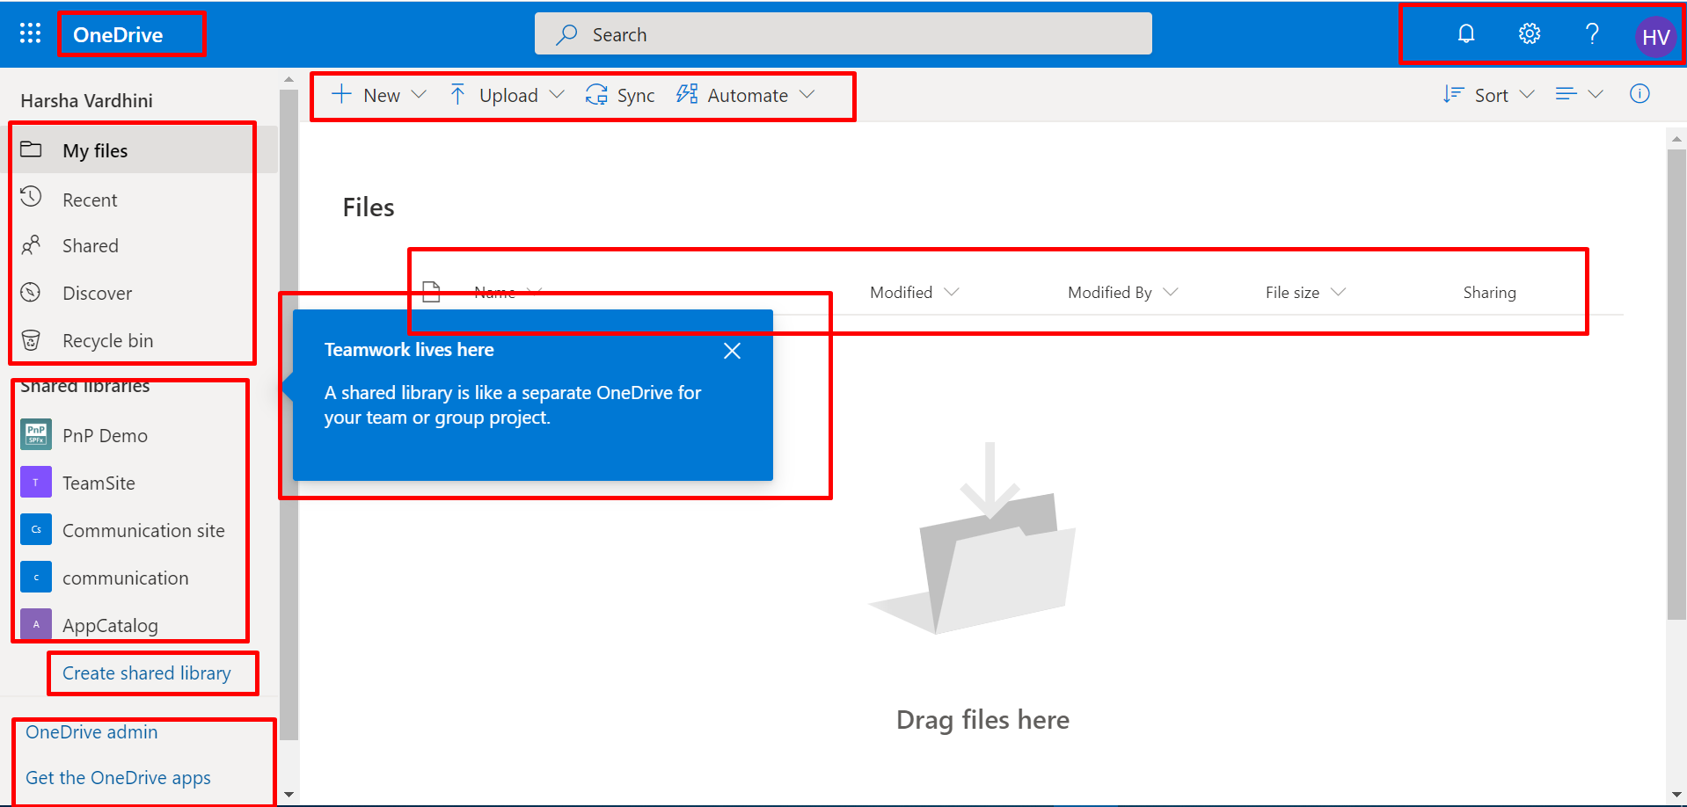
Introduction to fluent UI

Slide 9
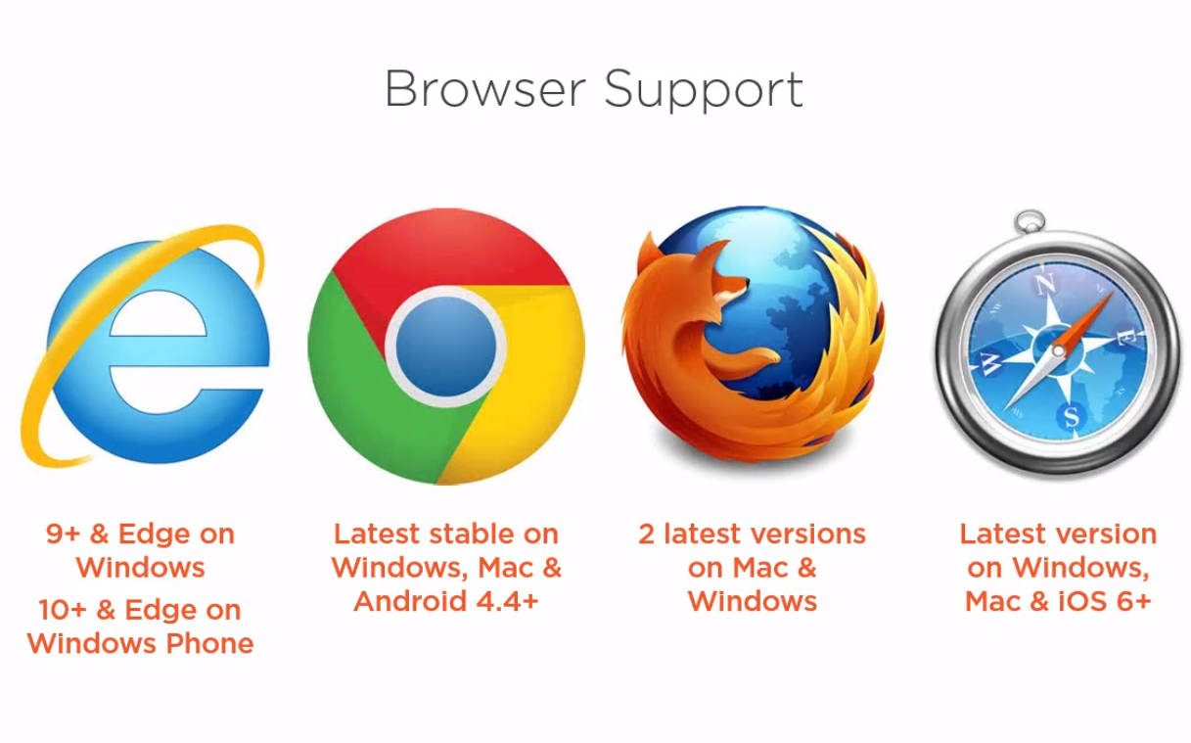

Slide 10
Flavors of fluent UI
Fluent UI for the web is available in two flavors: Fluent UI React and Fabric Core.
Fluent UI React
Fluent UI React is the official open-source React front-end framework designed to build experiences that fit seamlessly into a broad range of Microsoft products. It provides robust, up-to-date, accessible components which are highly customizable using CSS-in-JS.
Fabric Core
Fabric Core is an open-source collection of CSS classes and Sass mixins that give you access to colors, animations, fonts, icons and grid.
CDN Paths:
http://appsforoffice.microsoft.com/fabric/1.0/fabric.min.css
http://appsforoffice.microsoft.com/fabric/1.0/fabric.components.min.css

Slide 11
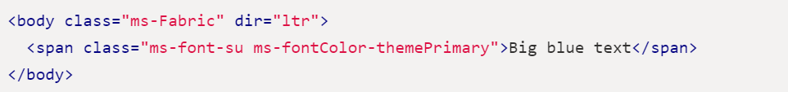
Fabric Core
Fabric Core is primarily meant for non-React applications or static pages.
If you're using Fluent UI React, you may not need Fabric Core. Most of the styles from Fabric Core are also available via CSS-in-JS styling, which is the recommended styling approach with Fluent UI React. Reference - https://developer.microsoft.com/en-us/fabric-js/getstarted/getstarted
Adding Fabric Core to your site
To add the latest version of Fabric Core to your site, link to this CSS file in the <head> of your webpage.
<link rel="stylesheet" href=https://static2.sharepointonline.com/files/fabric/office-ui-fabric-core/11.0.0/css/fabric.min.css />
Using Fabric Core class names
To use the styles, add the ms-Fabric class to a containing element, such as <body>, to set the font-family for all Fabric Core typography classes used within that element. Then apply the Fabric Core styles directly to your HTML elements.

Slide 12
Fluent UI React
Getting started developing with Fluent UI React is simple!
Add to existing project
Fluent UI React is available via the @fluentui/react npm package. To use this package in an existing project:
with npm
npm install office-ui-fabric-react
npm install @fluentui/react
with yarn
yarn add @fluentui/react
import { PrimaryButton } from '@fluentui/react';

Slide 13





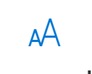

Fabric Core Styling
Colors
Layouts
Elevation
Iconography
Motion
Elevation
Motion
Colors
Elevation
Iconography
Layouts
Motion
Typography
Localization

Slide 14
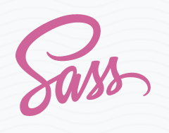

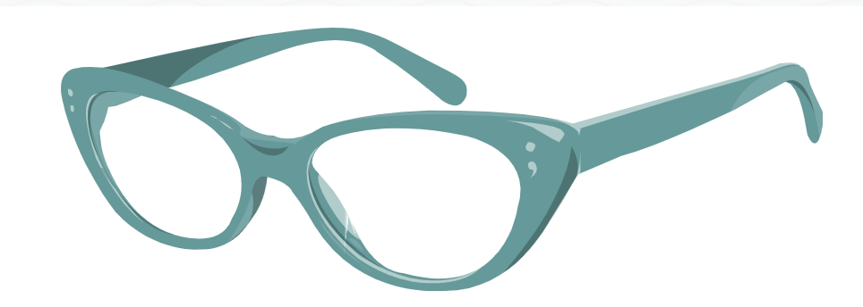
Sass is the most mature, stable, and powerful professional grade CSS extension language in the world.
Preprocessing
CSS on its own can be fun, but stylesheets are getting larger, more complex, and harder to maintain.
This is where a preprocessor can help.
Sass lets you use features that don't exist in CSS yet like variables, nesting, mixins, inheritance and other nifty goodies that make writing CSS fun again.
Once you start tinkering with Sass, it will take your preprocessed Sass file and save it as a normal CSS file that you can use in your website.
Reference for Mixins
https://sass-lang.com/documentation/at-rules/mixin

Slide 15
Typography
Typography is the art of arranging letters and text in a way that makes the copy legible, clear, and visually appealing to the reader.
Typography involves font style, appearance, and structure, which aims to elicit certain emotions and convey specific messages.
Typography should guide and inform your users, optimize readability and accessibility, and ensure an excellent user experience.
MS office has the license to use Segoe font.
Reference:
https://developer.microsoft.com/en-us/fluentui#/styles/web/typography

Slide 16
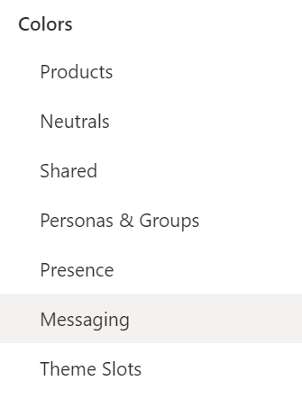
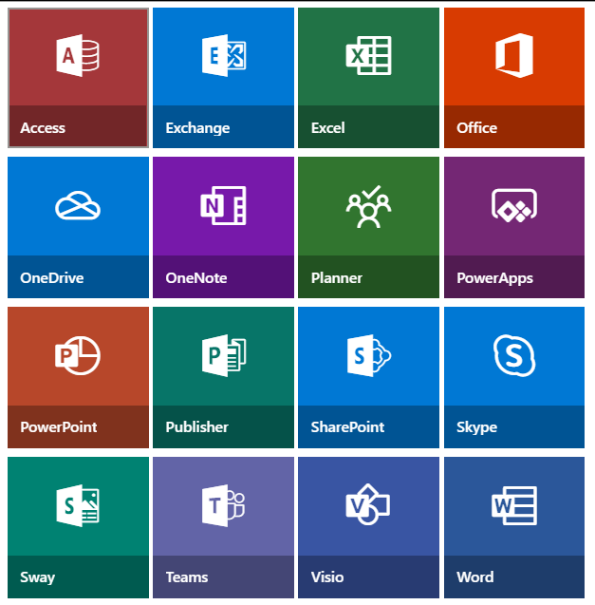
Colors
Colors used for
Background
Font
Border
Hover

Slide 17
Elevation
Depth:
Depth is used to draw focus to an experience and add a physical materiality to the app. Shallow levels are reserved for items that are closely connected to the canvas or view, such as tiles. Deeper levels create a prominent frame around the surface, drawing strong focus to self-contained experiences like dialogs.
Reference:
https://developer.microsoft.com/en-us/fluentui#/styles/web/elevation

Slide 18




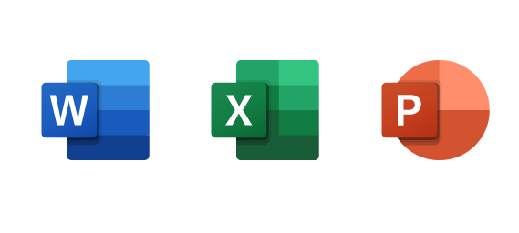


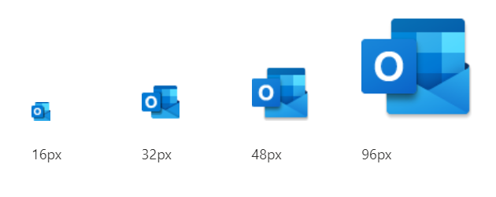
Iconography
Provides 338 scalable vector icons
Technically these are fonts, and not images
Color
Size
Opacity
You can call it as “Font Awesome for Office”.
Differences
Office UI Fabric Font Awesome

Slide 19
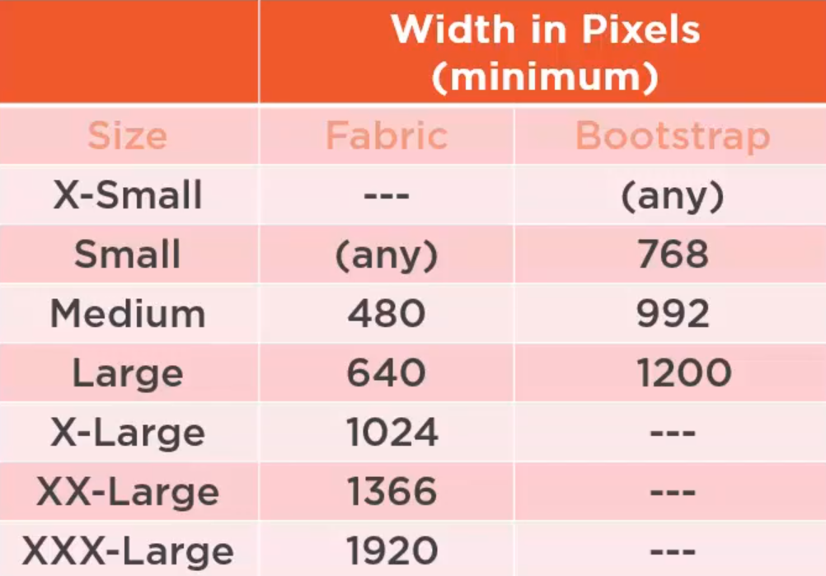
Layouts
Fabric Core comes with a mobile-first, 12-column, responsive grid that you can use to create flexible layouts for a variety of screen sizes and device types.
12 column concept
Media queries
Supports modern resolution
Responsive

Slide 20

Layouts
Screen width : 400
ms-u-sm2 ms-u-x14 ms-u-xxx16
Screen width : 1024
ms-u-sm2 ms-u-x14 ms-u-xxx16
Screen width : 1920
ms-u-sm2 ms-u-x14 ms-u-xxx16

Slide 21




Localisation
RTL Right to left language support
Primarily for Arabic and Hebrew
Implementation:
dir attribute: dir =‘rtl’
RTL version of fabric css: fabric.rtl.css
Reverse grid columns
Reversed icons
Language optimized fonts
Default
Segoe UI
Western European character set
Font stack based on lang attribute

Slide 22
Motion
Attention
Interactivity
Motion-Up/Down, Left/Right
Enter/Exit
Zoom-In /Zoom-out

Slide 23
Demo – Fluent UI In SPFx webpart
Fabric components

Slide 25
PnP Controls for SPFx
By Siddharth Vaghasia on 13th May, 2020

